Slide 1
Welcome to Artificial Intelligence
What is AI?
Historical foundations
The evolution of AI
Current state of the art
Risks and benefits
"We call ourselves Homo sapiens—man the wise—because our intelligence is so important to us."

Slide 2
What is Artificial Intelligence?
Before we can build AI, we must answer:
  What does "intelligence" mean?
  What does "artificial" mean in this context?
  How do we know if we've achieved it?
  What are we actually trying to create?
This is not just philosophical—it guides:
  Research directions
  Algorithm design
  Evaluation criteria
  Success metrics

Slide 3
The Challenge of Defining AI
Intelligence is multifaceted:
  Reasoning and logic
  Learning from experience
  Understanding language
  Perceiving the environment
  Solving problems
  Making decisions
  Creating and adapting
Different stakeholders care about different aspects:
  Cognitive scientists → Understanding human thought
  Engineers → Building useful systems
  Philosophers → Nature of mind and consciousness
  Business → Practical applications

Slide 4
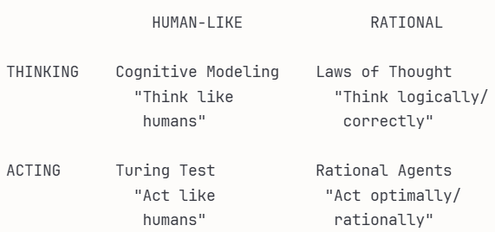
Four Approaches to AI
Two Key Dimensions
Dimension 1: The Standard
  Human-like: Measure against human performance
  Rational: Measure against ideal "correct" behavior
Dimension 2: The Focus
  Thinking: Internal reasoning processes
  Acting: External behavior/actions
Combining these gives us 4 distinct approaches:

Slide 5
Approach 1: Acting Humanly - The Turing Test
The Turing Test (1950)
Alan Turing's Question:
  "Can machines think?"
His Answer:
  Let's not argue about definitions—let's create an operational test!
The Test:
Human Interrogator
↓ (asks questions)
[Computer] or [Human]?
↓ (written responses)
Can interrogator tell which is which?
If computer fools interrogator → "intelligent"

Slide 6
Turing Test - What It Requires
1. Natural Language Processing (NLP)
  Understand questions in English/other languages
  Generate coherent, contextual responses
  Handle ambiguity, idioms, context
2. Knowledge Representation
  Store facts about the world
  Organize information usefully
  Retrieve relevant knowledge
3. Automated Reasoning
  Draw logical conclusions
  Answer questions from stored knowledge
  Make inferences
4. Machine Learning
  Adapt to new patterns
  Improve from experience
  Detect trends in conversation

Slide 7
Turing Test - Extended Version
Addition: Physical interaction with the world
Extra Requirements:
  Computer Vision: See and interpret images
  Robotics: Manipulate objects, move around
  Speech Recognition: Understand spoken language
Example Scenario:
Interrogator: "Can you pass me the red ball?"
AI must:
- Understand speech
- Identify "red ball" through vision
- Use robotic arm to grasp and pass it

Slide 8
Turing Test - Why It's Not The Goal
Interesting but Not Definitive
Why researchers moved on:
Not all intelligence is human-like
  Calculators aren't "intelligent" but outperform humans at math
  Chess computers play brilliantly but differently than humans
Deception isn't intelligence
  Chatbots can fool people without understanding
  Passing the test ≠ true intelligence
Wrong focus
  Like defining "artificial flight" as "fooling birds"
  Better to understand principles of flight/intelligence
Analogy:
  Aeronautical engineering doesn't try to make machines that fly "exactly like pigeons"
  AI shouldn't just mimic humans—should understand intelligence principles

Slide 9
Approach 2: Thinking Humanly - Cognitive Modeling
Understanding the Human Mind
Goal: Build programs that think like humans actually think
The Process:
  Study how humans think (through psychology/neuroscience)
  Build computational models
  Compare model behavior to human behavior
  Refine model
Key Insight:
  If a program’s reasoning steps match human reasoning, then the program may be using similar underlying mechanisms to the human mind.

Slide 10
Cognitive Modeling - Example
GPS: General Problem Solver (1961)
Newell & Simon's Approach:
  Human solving puzzle:
  1. Notices difference from goal
  2. Finds operator to reduce difference
  3. Applies operator
  4. Repeats
  GPS algorithm:
  1. Identify difference from goal
  2. Select operator to reduce difference
  3. Apply operator
  4. Repeat
Validation:
  Time each step
  Record which subgoals considered
  Compare to human protocol

Slide 11
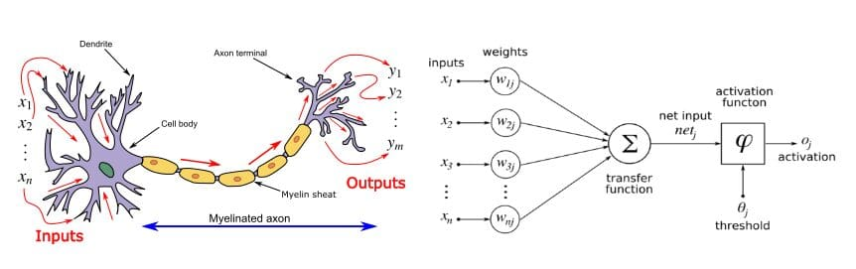
Cognitive Modeling - Modern Example
Deep Learning and the Brain
Neural Networks:
  Inspired by brain structure
  Artificial "neurons" connected in layers
  Learn by adjusting connection strengths
Not exactly like the brain, but:
  Visual processing networks mirror visual cortex organization
  Learning rules inspired by synaptic plasticity
  Useful for both AI and neuroscience
Bidirectional benefit:
  AI → Models to test theories of cognition
  Neuroscience → Inspiration for AI architectures

Slide 12
Cognitive Science - The Field
Interdisciplinary Study of Mind
Cognitive Science combines:
  Psychology (experimental methods)
  Computer Science (computational models)
  Neuroscience (brain mechanisms)
  Linguistics (language processing)
  Philosophy (fundamental questions)
  Anthropology (cultural cognition)
Central Tenet:
  "A cognitive theory should be like a computer program"
Distinction from AI:
  Cognitive science: Understand human/animal cognition
  AI: Build intelligent systems (may or may not be human-like)

Slide 13
Approach 3: Thinking Rationally - Laws of Thought
The Logical Tradition
Ancient Goal: Codify "right thinking"
Aristotle's Syllogisms (circa 350 BCE):
  Major premise: All men are mortal
  Minor premise: Socrates is a man
  Conclusion: Therefore, Socrates is mortal
If premises are true and reasoning valid → conclusion must be true

Slide 14
Laws of Thought - The Logicist Program
Using Logic for AI
19th Century Development:
  George Boole: Boolean algebra (1847)
  Gottlob Frege: First-order logic (1879)
  Precise notation for statements about the world
The Logicist Vision (1960s):
  Represent knowledge in logical notation
  Use inference rules to derive conclusions
  Solve problems through logical deduction
Example:
  Knowledge base:
    At(Agent, Arad)
    Road(Arad, Sibiu)
    Road(X,Y) → CanDrive(X,Y)
  Inference:
    CanDrive(Arad, Sibiu)

Slide 15
Laws of Thought - Limitations
Why Pure Logic Isn't Enough
Problem 1: Uncertainty
  Logic requires certainty
  Real world is uncertain
  "It will probably rain" can't be represented in classical logic
Problem 2: Intractability
  Can prove theorems in principle
  In practice: computationally explosive
  Finding proofs may take forever
Problem 3: Knowledge Acquisition
  How do we get all the rules?
  World is too complex to enumerate all facts
  Commonsense knowledge is vast

Slide 16
From Logic to Probability
Handling Uncertainty
Transition in AI (1980s-1990s):
Old approach:
  Bird(Tweety) ∧ Bird(X) → CanFly(X)
  Therefore: CanFly(Tweety)
New approach:
  Bird(Tweety)
  P(CanFly | Bird) = 0.95
  Therefore: P(CanFly(Tweety)) = 0.95
Probability theory:
  Rigorous framework for uncertainty
  Allows reasoning with incomplete information
  Bayesian networks, probabilistic reasoning (Chapters 12-18)

Slide 17
Thinking vs. Acting
The Action Gap
Problem with "thinking" approaches:
  Rational thought alone doesn't produce behavior
  Can think correctly but still fail to act
Example:
  You logically deduce the best route to take
  But you never actually drive!
  Intelligence requires ACTION, not just thought
This motivates the "acting" approaches...

Slide 18
Approach 4: Acting Rationally - The Rational Agent
What is a Rational Agent?
Definition:
  An agent that acts so as to achieve the best outcome (or best expected outcome under uncertainty)
Key Components:
  Agent: Something that perceives and acts
  Rational: Does the "right thing"
  Right thing: Achieves best outcome according to performance measure
Not just thinking—DOING!

Slide 19
Rational Agents - Why This Approach Won
Advantages Over Other Approaches
1. More General than "Laws of Thought"
  Logical inference is just one mechanism
  Can use probability, heuristics, learning, etc.
  Not restricted to deductive reasoning
2. More Rigorous than "Human-like"
  Mathematically well-defined
  Can prove properties of algorithms
  Clear success criteria
3. Action-oriented
  Focuses on what matters: behavior
  Includes both thinking and acting
  Complete picture of intelligence

Slide 20
Rational Agents - The Standard Model
The Dominant Paradigm in AI
Core Idea:
  Design agents that maximize performance measure
    Given:
      - Percept sequence (what agent has observed)
      - Actions available
      - Performance measure (what we want achieved)
    Agent chooses action that maximizes expected performance
This framework includes:
  Control theory (minimize cost function)
  Operations research (maximize reward)
  Economics (maximize utility)
  Statistics (minimize loss function)
Unified mathematical foundation across disciplines!

Slide 21
Rational Agent Example
Automated Taxi Driver
Performance Measure:
  Safe arrival
  Minimize time
  Obey traffic laws
  Comfortable ride
  Minimize fuel cost
Rational behavior:
  At intersection, agent must:
    1. Perceive: traffic light, other cars, pedestrians
    2. Reason: What action achieves best outcome?
    3. Act: Turn left/right/straight, or wait
  Choice maximizes expected performance (balancing safety, speed, comfort, legality)
Not about thinking like human driver—about achieving goals!

Slide 22
Limited Rationality
Refinement: Perfect Rationality is Impossible
Problem:
  Optimal action may require infinite computation
  Must decide in finite time
  Perfect rationality is infeasible
Solution: Limited (Bounded) Rationality
  Act appropriately given computational constraints
  "Good enough" decisions in available time
  Satisficing vs. optimizing
Example:
  Chess: Can't compute optimal move (too complex)
  Instead: Compute best move in available time
  Still rational given constraints!

Slide 23
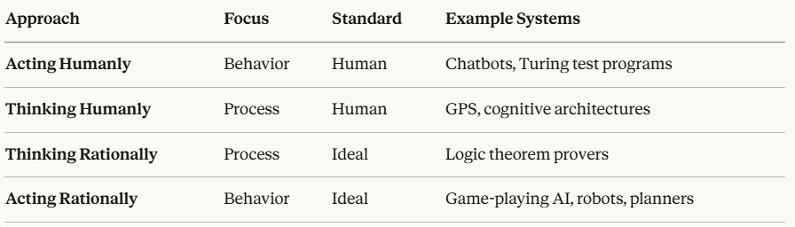
The Four Approaches - Summary Table
Historical trend: Movement toward "Acting Rationally"

Slide 24
Why We Focus on Rational Agents
This Course's Approach
Rational agent paradigm because:
Mathematically precise
  Can analyze, prove properties
  Clear optimization targets
Generally applicable
  Works for games, robotics, planning, etc.
  Unified framework
Practical
  Achieves goals in real world
  Measurable success
Extensible
  Can incorporate learning
  Handles uncertainty
  Scales to complex problems

Slide 25
The Approaches Are Not Exclusive
They Complement Each Other
In Practice, Modern AI Uses All Four:
Self-driving car example:
  Acting Humanly:
    Interface must be natural for passengers
  Thinking Humanly:
    Predict what human drivers will do
  Thinking Rationally:
    Plan optimal routes using logic/probability
  Acting Rationally:
    Make driving decisions that maximize safety/efficiency
Different aspects of intelligence require different approaches!

Slide 26
Evolution of AI Definitions
Historical Progression
1950s-60s: "Making machines think"
  Focus on reasoning, logic
  Symbolic AI, theorem proving
1970s-80s: "Making machines do intelligent things"
  Focus on expert systems
  Knowledge engineering
1990s-2000s: "Making machines learn"
  Focus on data-driven methods
  Statistical learning
2010s-present: "Making machines that help humans"
  Focus on beneficial AI
  Human-AI collaboration

Slide 27
Modern Perspective: Beneficial AI
Beyond the Standard Model
New Challenge:
  What if we can't specify the objective perfectly?
  What if the objective is uncertain?
  What if the objective changes?
Value Alignment Problem:
  Old: Put objective O into machine → Machine maximizes O
    Problem: What if O isn't quite right?
  New: Machine knows it's uncertain about objective
    → Machine learns human preferences
    → Machine acts cautiously
This is the frontier of current AI research!

Slide 28
Practical Implications
How Definitions Shape AI Development
"Acting Humanly" (Turing Test) Led To:
  Natural language processing
  Chatbots, dialogue systems
  Humanoid robots
"Thinking Rationally" (Logic) Led To:
  Expert systems
  Knowledge bases
  Automated reasoning
"Acting Rationally" (Agents) Led To:
  Game-playing AI (Chess, Go)
  Autonomous vehicles
  Robotic planning
Different definitions → Different technologies!

Slide 29
Benefits of AI
Potential Positive Impacts:
  Economic Growth: Increased productivity, new goods/services
  Scientific Advancement: Climate science, drug discovery
  Health Care: Better diagnostics, personalized treatment
  Accessibility: Services for underserved populations
  Safety: Reduced accidents, disaster prediction
"First solve AI, then use AI to solve everything else." - Demis Hassabis

Slide 30
Risks of AI - Current Concerns
Immediate Risks:
  Lethal Autonomous Weapons
  Scalable, no human supervision required
  Surveillance and Persuasion
  Mass monitoring, behavior manipulation
  Biased Decision Making
  Discriminatory loan/parole decisions
  Employment Impact
  Job displacement, wealth inequality
  Safety-Critical Applications
  Self-driving cars, infrastructure management
  Cybersecurity
  AI-powered attacks (phishing, malware)

Slide 31
The Path Forward
Human-Level AI (HLAI):
  Machines that can learn to do anything a human can do
  First symposium: 2004
Artificial General Intelligence (AGI):
  Intelligence across all domains
  First conference: 2008
Current Consensus:
  Need both theoretical breakthroughs and engineering advances
  "Faster machines just give you the wrong answer faster" without right theory

